Slide 1

CS Project: CH4
By: Khoo Kai Wen

Slide 2
Description
CH4
An organic chemistry application
Intended to help students learn about organic chemistry and organic compounds via hands-on learning
Allows students to create organic molecules, learn about their properties and interact with experiments

Slide 3
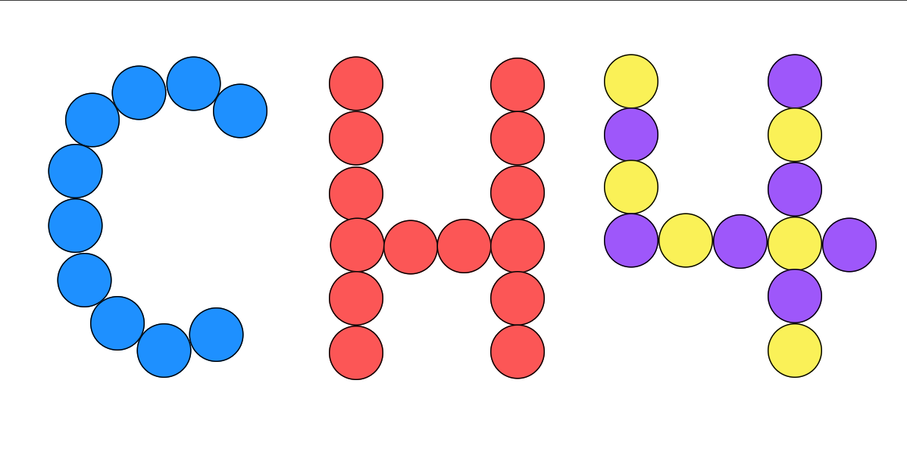
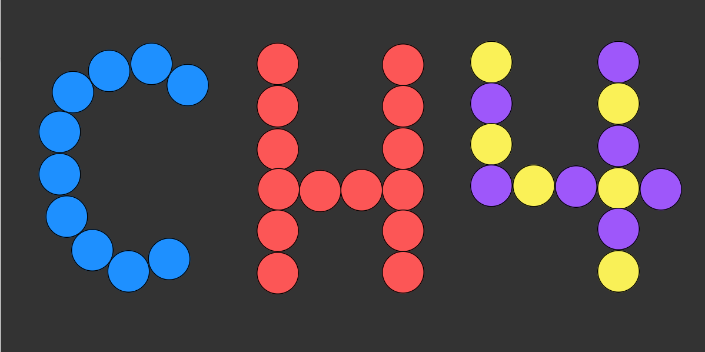
Splash Screen
Light Mode Splash Screen
Dark Mode Splash Screen

Slide 4
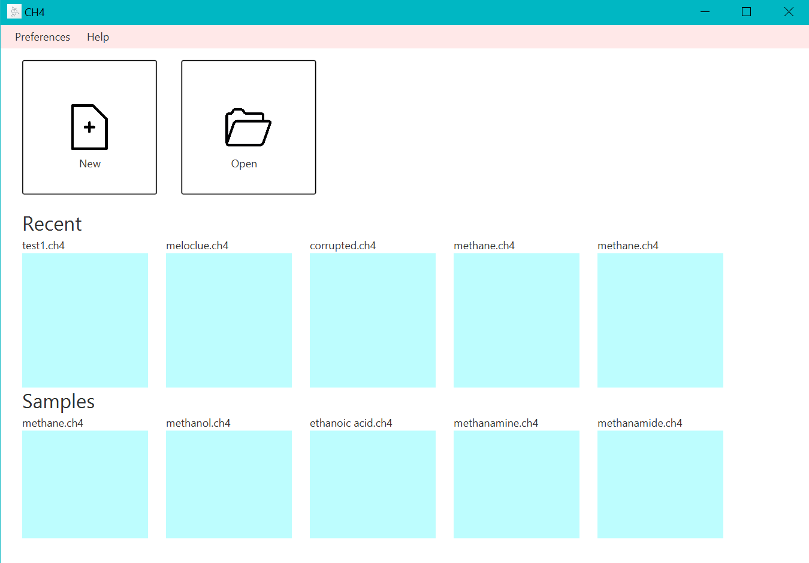
Project View
The user can create or open a .ch4 file
Open recent files from “Recent”.
“Samples”
Sample files cannot be edited.

Slide 5
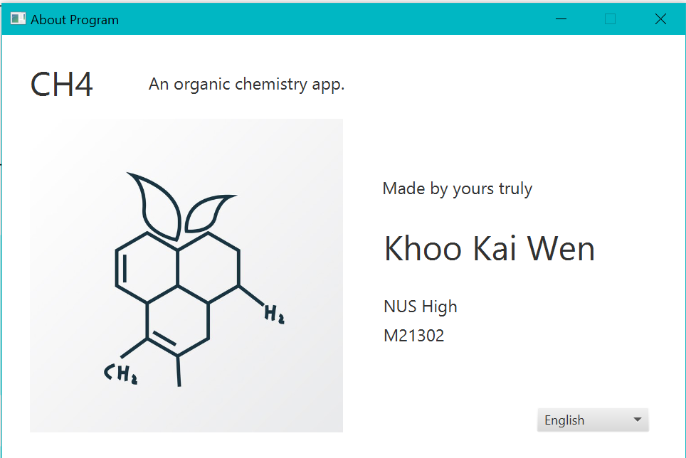
About Program
Internalisation
ResourceBundle
Language options: English, Chinese, Malay, French

Slide 6
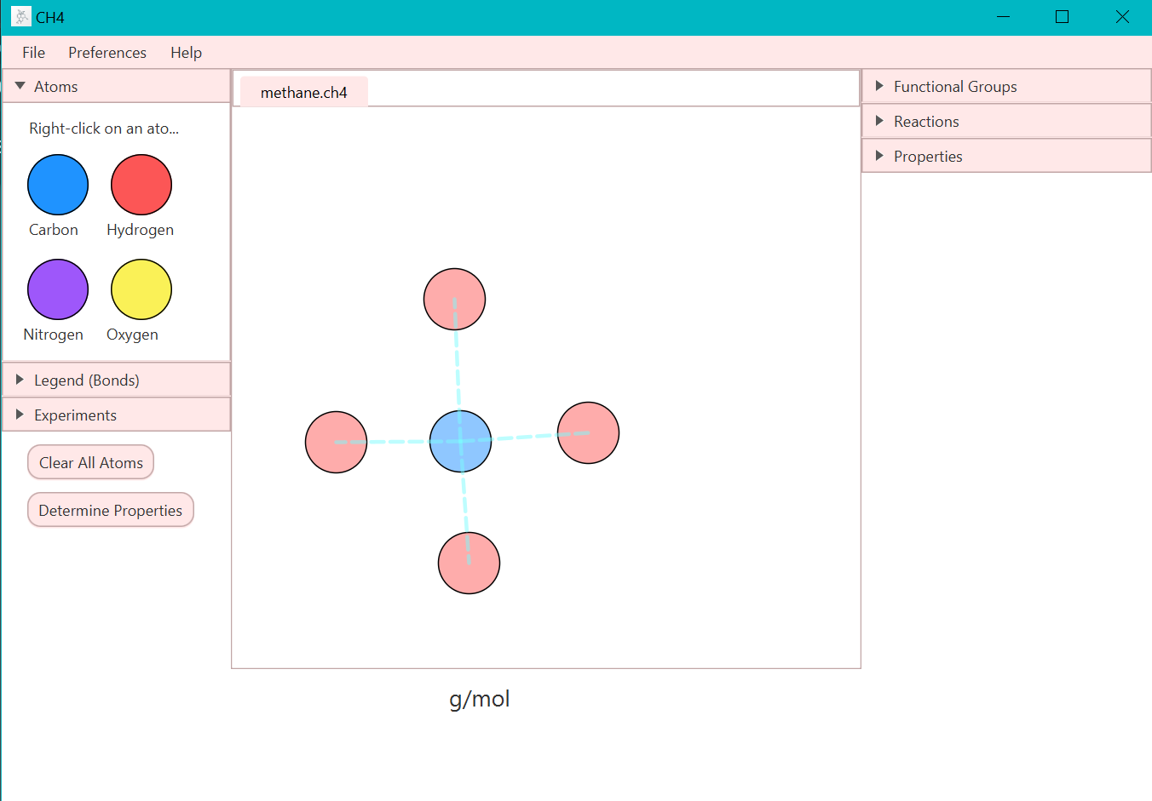
Workspace

Slide 7
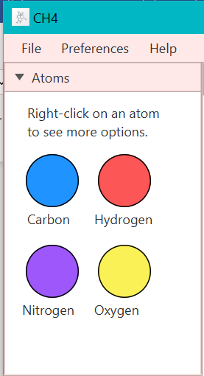
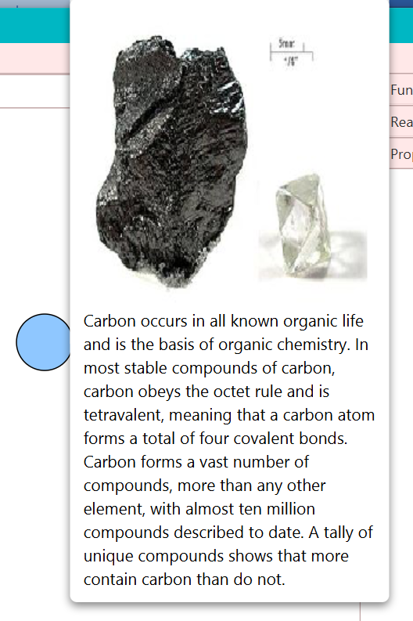
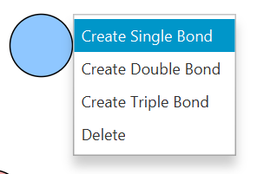
1. Drag and Drop Atoms
By clicking on an atom in the “Atoms” titledpane, the atom will appear in the canvas. The atom is draggable.
By right-clicking on the atom, users can create bonds and delete the atom.
The atoms also have custom tooltips which display useful information about the atom for users to learn.

Slide 8
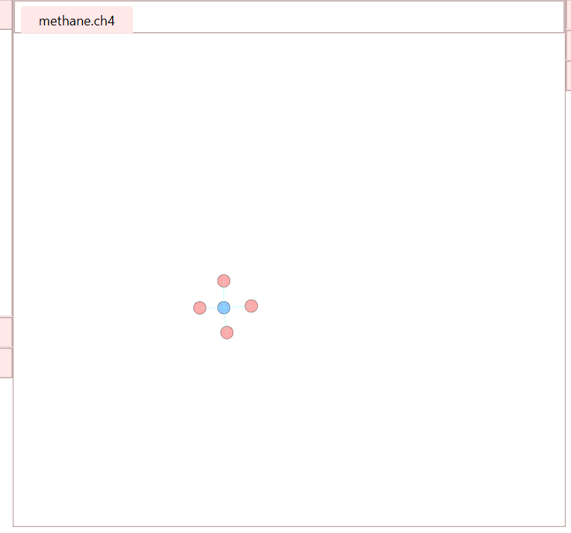
2. Canvas
Zoomable by scrolling mouse
Pannable via holding the right mouse button and dragging over the canvas

Slide 9
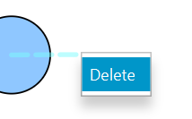
3. Bonds
Bond creation
Bond deletion -> A bond can be deleted by right-clicking on it and selecting the “delete” option.
UI -> The bond is bound to the atoms, so when the atoms it is bound to are dragged, the bond moves with the atoms.

Slide 10

4. Clear Canvas
All atoms will be cleared from the canvas.

Slide 11

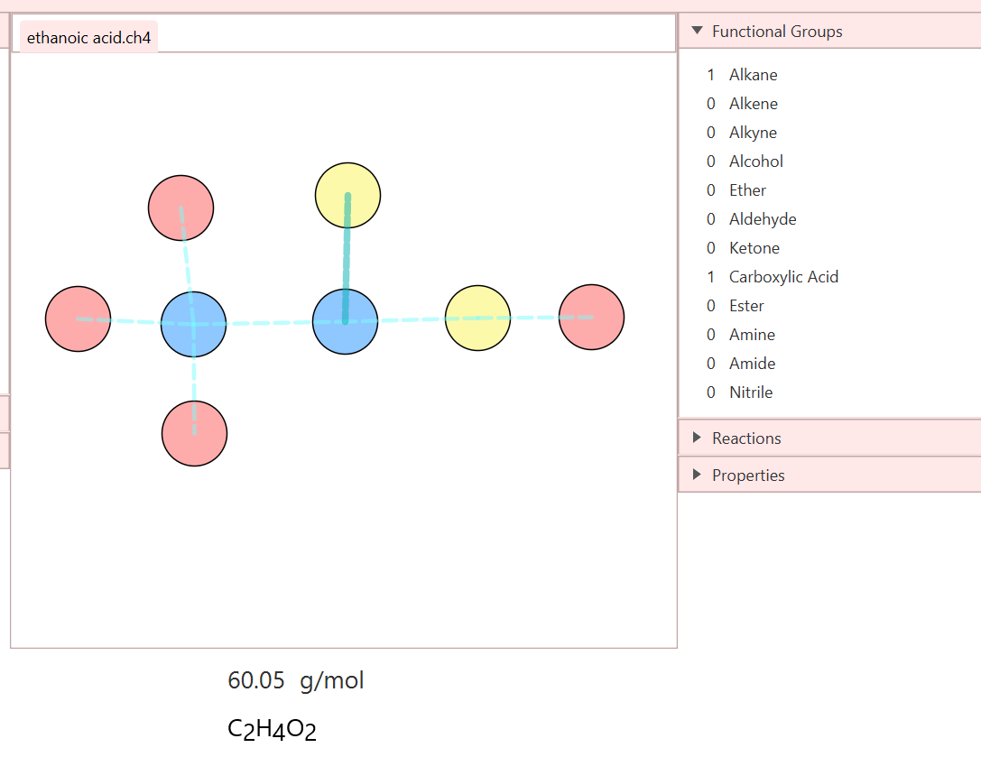
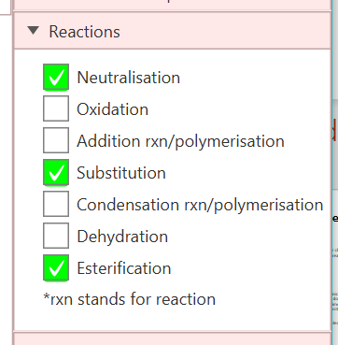
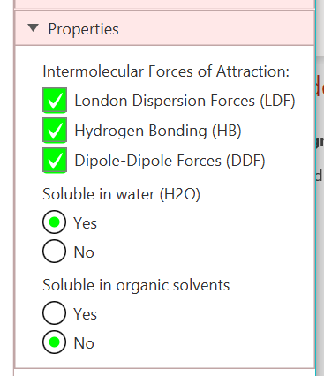
5. Analyses Properties of Molecule
If the molecule is complete and the user clicks this button, CH4 will analyse the molecule created by the user and display its properties.
Properties:
Mass of molecule in g/mol
Formula of molecule created
Identifying the number and types of organic functional groups present in the molecule.
Reactions and other properties of the molecule, derived from the functional groups identified

Slide 12
6. File I/O
Users can save and load .ch4 files of their molecule into the app.

Slide 13
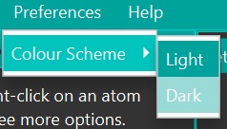
7. Dark/Light Mode
Theme is stored in a .txt file and read to determine if the app is currently in light or dark mode.
Stylesheet added accordingly

Slide 14
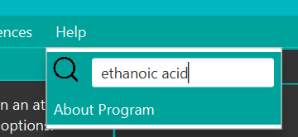
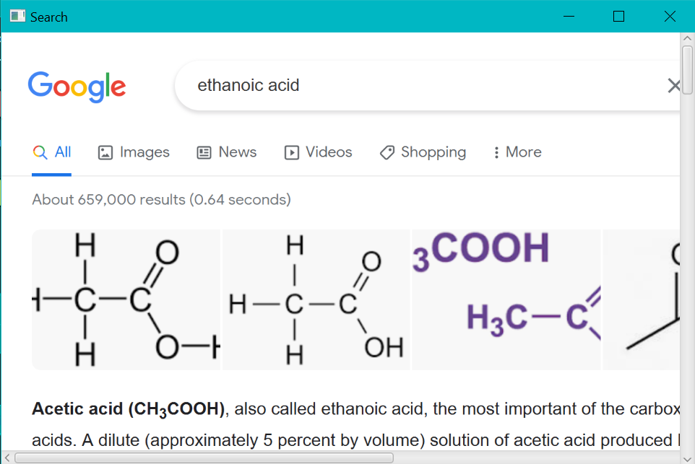
8. Search
Useful as students can easily search for organic compounds, terms and information they do not understand or wish to learn more about.

Slide 15
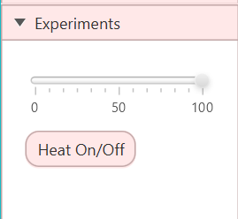
9. Experiments
1 Experiment: Turning the heat on and off, turning up the heat which vibrates the molecule

Slide 16
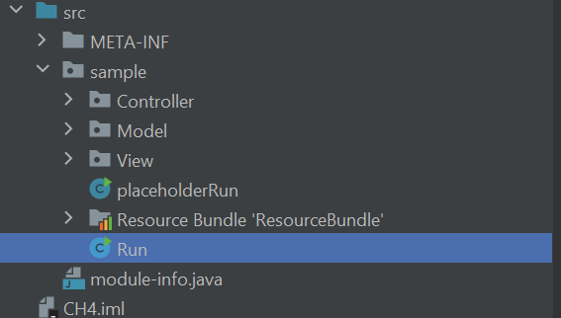
MVC Format

Slide 17
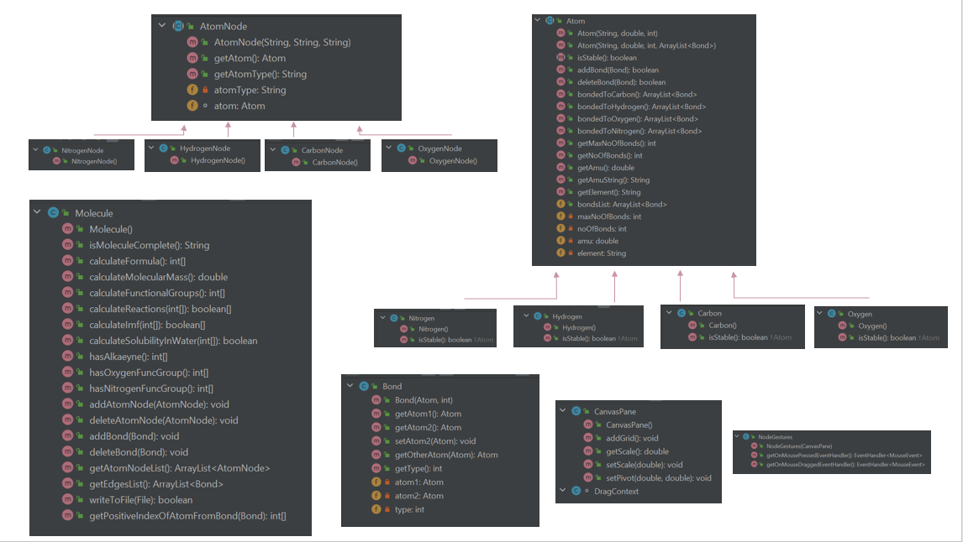
OOP Design

Slide 18
Testing
Manual testing was conducted to test every features.
Bugs were identified and fixed. An example is File I/O resulting in the molecule having no atoms as the molecule was not instantiated in the File I/O method.

Slide 19
Reflections: Obstacles
A large obstacle faced was the drag and drop functionality of the atoms and a zoomable and pannable canvas.
Many atoms to keep track off
Limitations: Chemistry

Slide 20
Reflections: Additional Features
Nomenclature
Planned to have this feature
But difficult task as nomenclature for organic compounds has many factors and functional groups to take note of
Would allow user to search up the molecule online and learn more about it
Highlighting of functional groups on molecule
Allow students to see and take note of its position to learn
More experiments other than turning up the heat
Multiple molecules

Slide 21
Reflections: JavaFX and Task
Learnt much more about JavaFX and different controls through this project
Learnt to appreciate the OOP design of Java as it allowed my app to be more organised and function more smoothly
Project task was enjoyable as we were allowed to choose our topic

Slide 22
insert project demo

Slide 23
